Slide 1





Gender Prediction
By Name
FEMALE
MALE

Slide 2



Problem Statement
Can you predict the gender of a person by their name?
Yes Sir!
It is quite easy

Slide 3
It is easy for you, but can u make your EXCEL do the same?
Is it even possible?

Slide 4
It’s also very easy.
Come let me show you the POWER of EXCEL

Slide 5
Methodology
Can you see some pattern..
Aarti, Khushi,Shruti
Ram,Shyam,Ghanshyam
Yes sir, last letter of their names.
Last letter of their name tells most about their gender so we will use this feature to train our excel

Slide 6


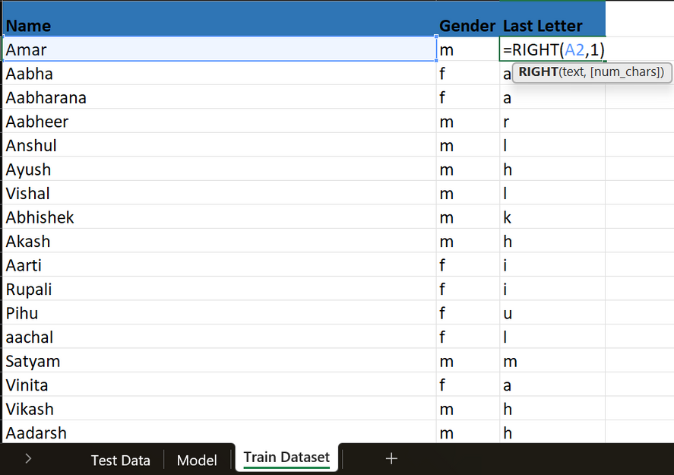
Take a large dataset of names with their gender. Find out the last letter of their name using =Right()

Slide 7
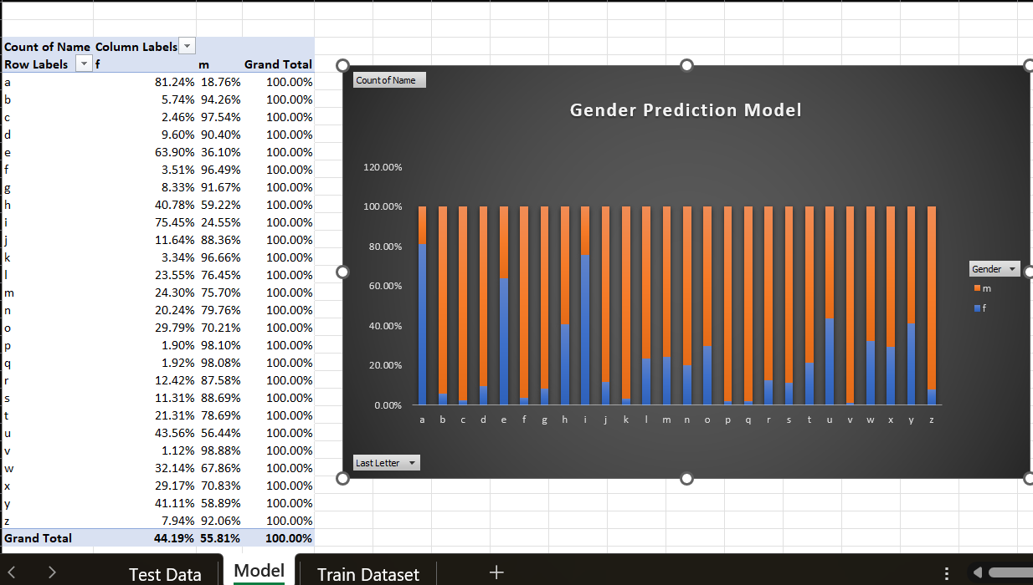
Make a pivot table of last letter and the count of Males and Females whose name ends on that letter.

Slide 8


Find out % of being Male And % of being Female of a given name by using a vlookup.
If male % if more than female % then print male else female.
Vlookup function
If Function

Slide 9
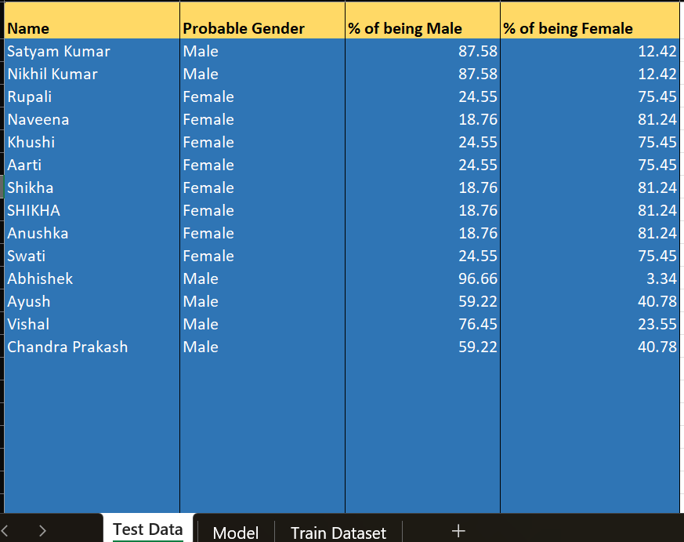

See Now your EXCEL can also predict gender just like you!
Wow Sir! It’s Great

Slide 10

By using only 3 functions and a pivot table, we can predict the gender of a person by knowing their name only. Isn’t it awesome?!!
Did you find this project exciting?
~by Satyam

